Slide 1


Time x Space
B-DEFYA
Group Emails
Daragh: daragh.oboyle@ucc.ie
Adriana: adriana.torres-ballesteros@rothamsted.ac.uk
Fynn: fbrix@foodtech.uni-kiel.de
Bruno: b.fosso@ibiom.cnr.it
Euan: bs14e3m@leeds.ac.uk
Yuvia: yuvia.perez-rico@embl.de

Slide 2
Research questions
What is the difference in Time and Space across three Methods ? (n=200)
How robust are the different methods towards varying sample sizes ? (n=15, 52, 89, 126, 163)
RAM footprint, speed - bar plot
Clustering performance - scatter plots
Can JIVE’s sensitivity increase if we allow the model to reach convergence?

Slide 3
Varying sample size
Objective 1 and 2
Subsets
1
2
3
4
5
6
Size (n)
15
52
89
126
163
200
+37
Methods
10 Subsets
MOFA
10 Subsets
JIVE
10 Subsets
MCIA
Computational complexity:
Run time
RAM usage

Slide 4

JIVE and Convergence
Objective 3
Enrichment
Data
Impute
JIVE - Convergence
Sensitivity

Slide 5
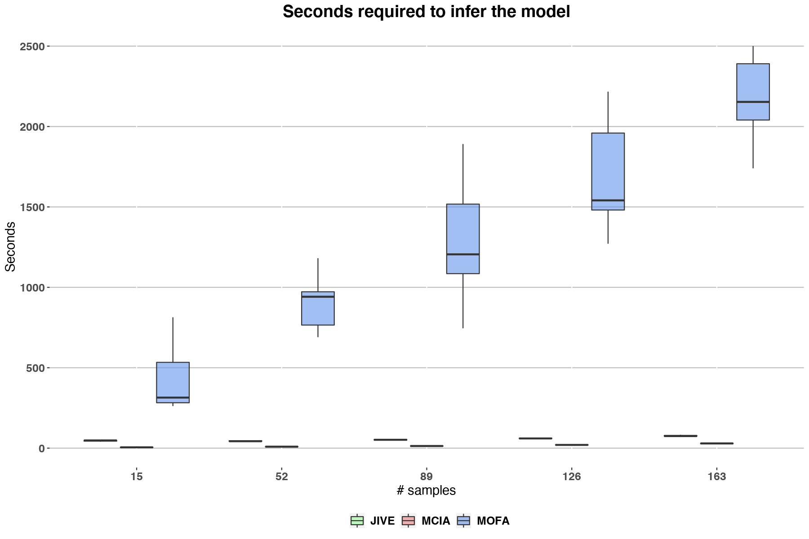
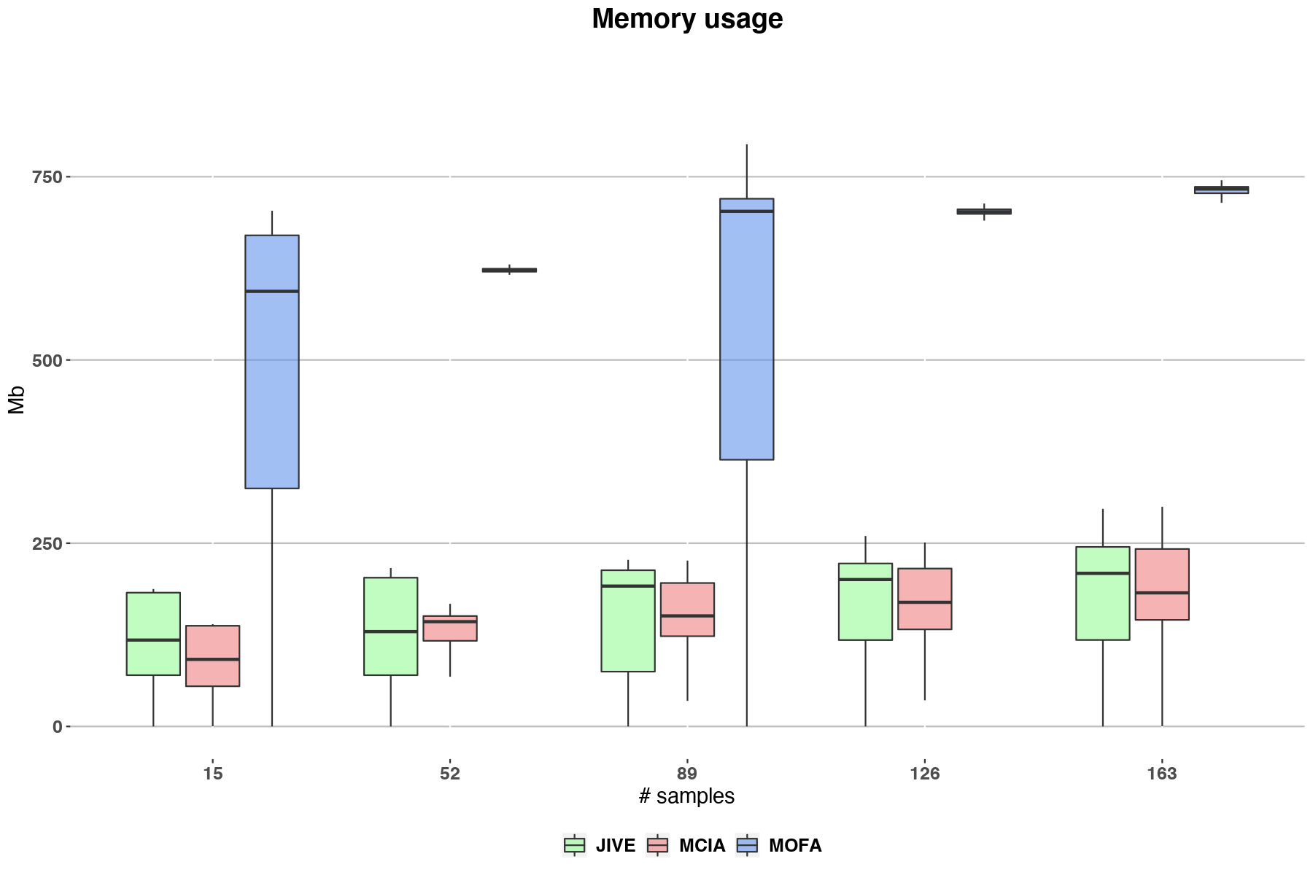
Time & Space - Sample Number

Slide 6
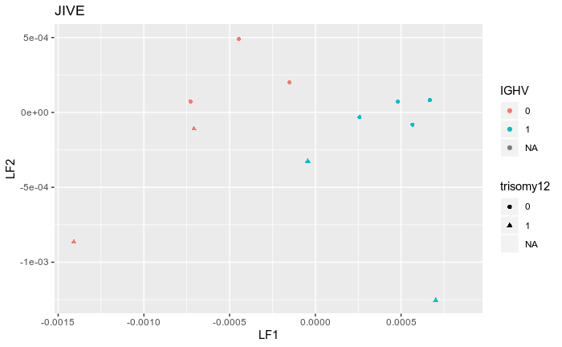
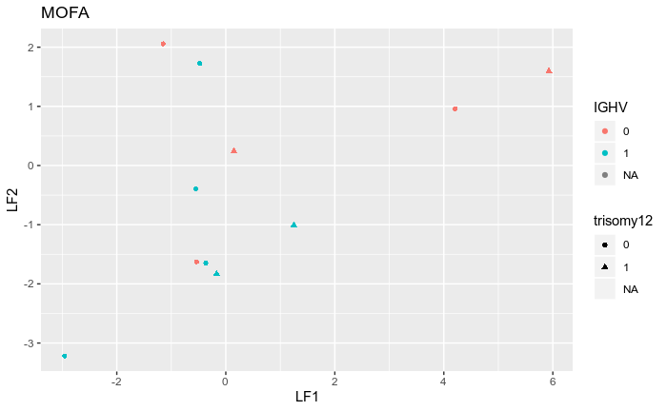
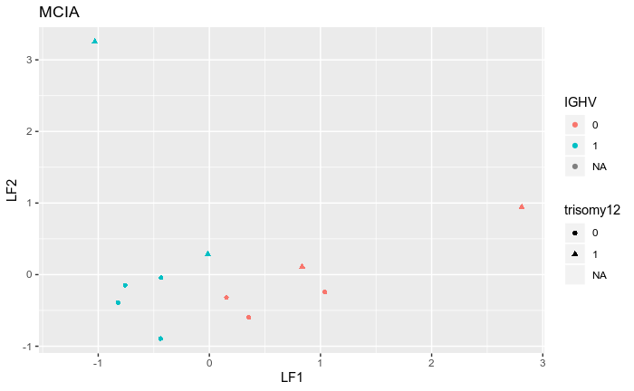
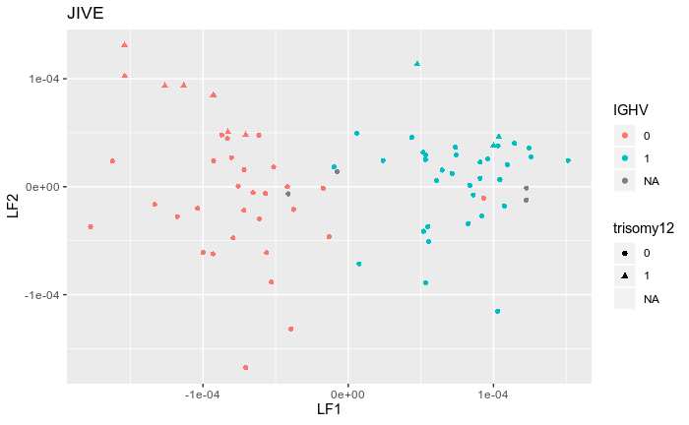
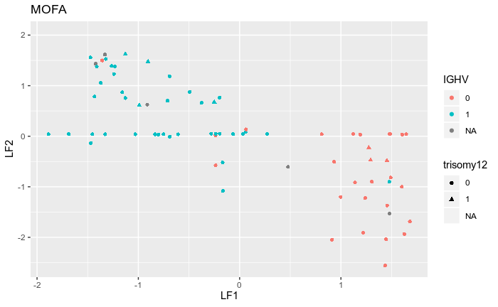
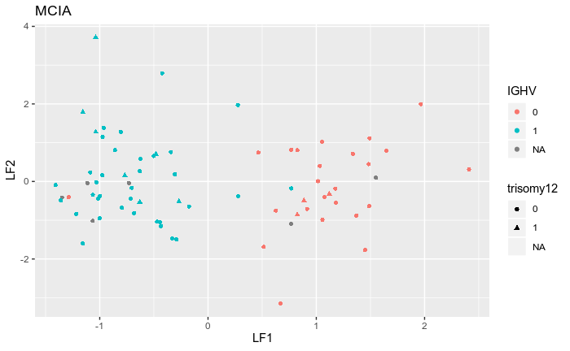
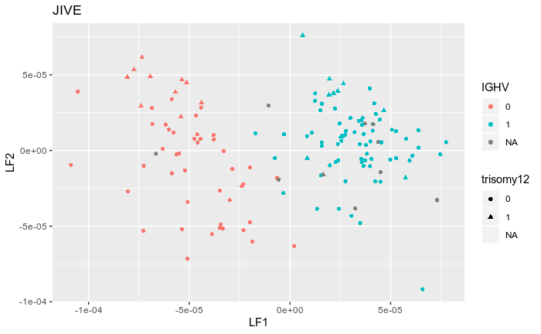
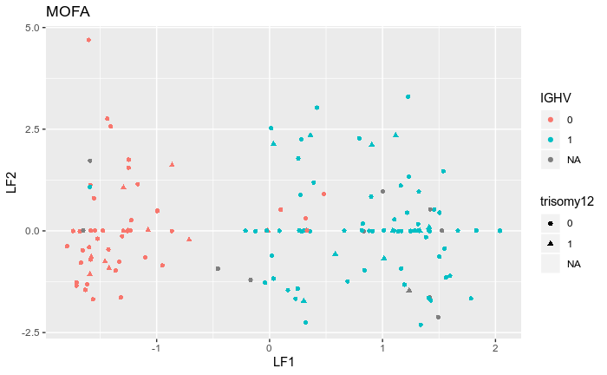
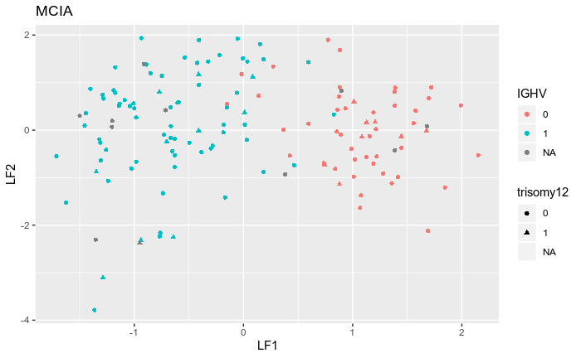
2. Clinical Discrimination - Sample number
JIVE
MOFA
MCIA
n=15
Increasing sample size
n=89
n=163
JIVE & MCIA discriminates IGHV status for all samples sizes, but not trisomy12 status
MOFA discriminates IGHV status for 89 & 163, but not trisomy12, lots of low/0-values for Factor 2

Slide 7
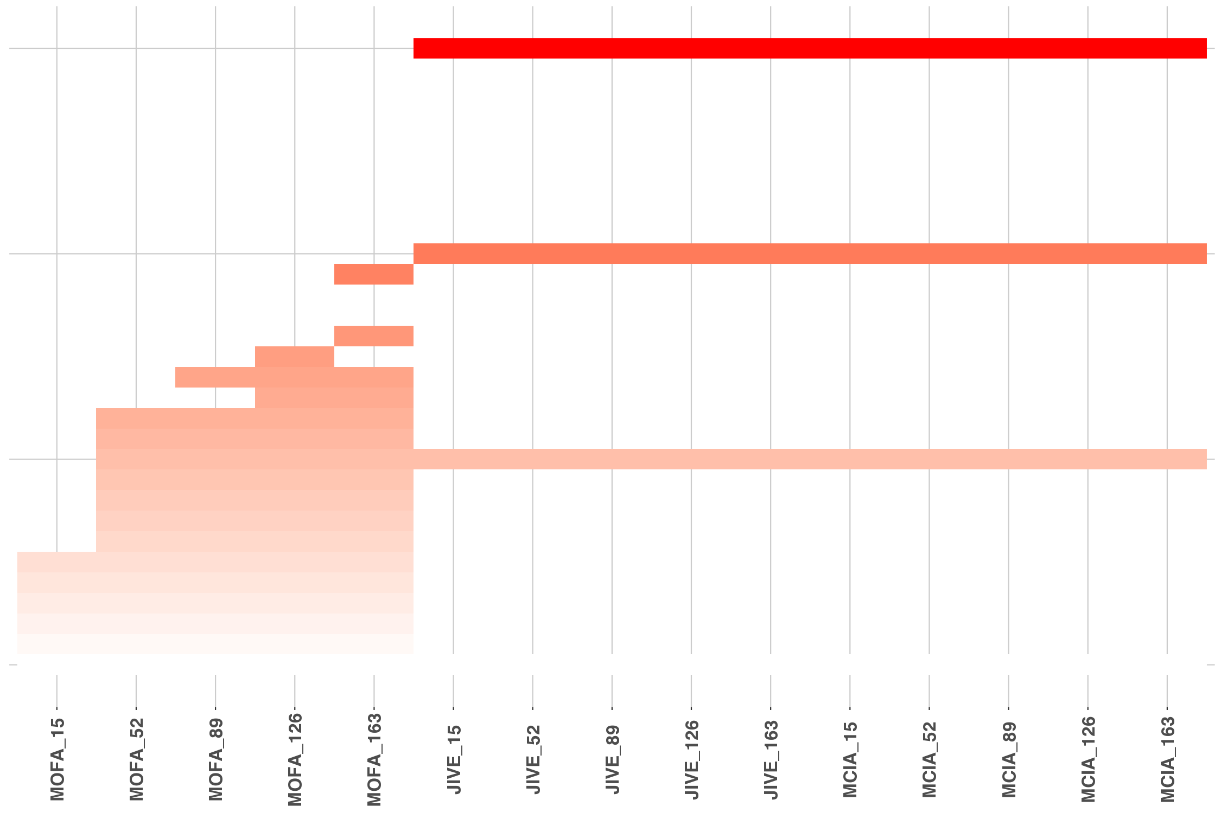
2. Features - Sample number

Slide 8
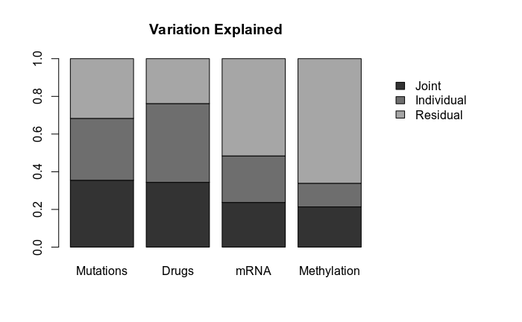

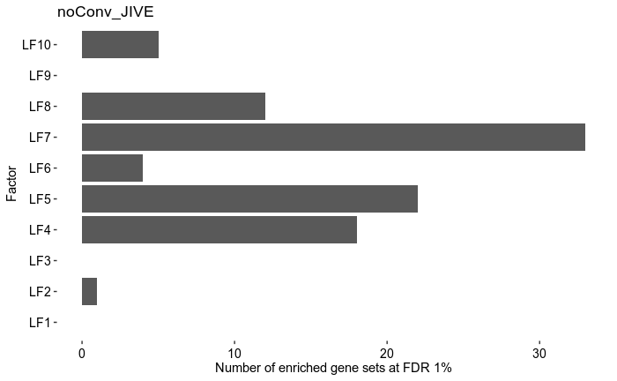
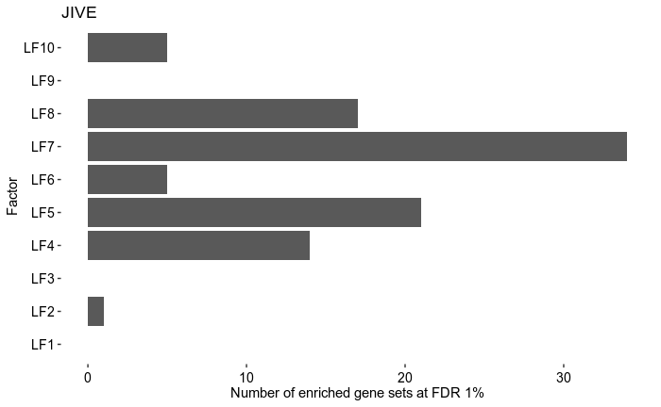
3. Comparison of JIVE results
No convergence (100 iterations)
With convergence (291 iterations)

Slide 9
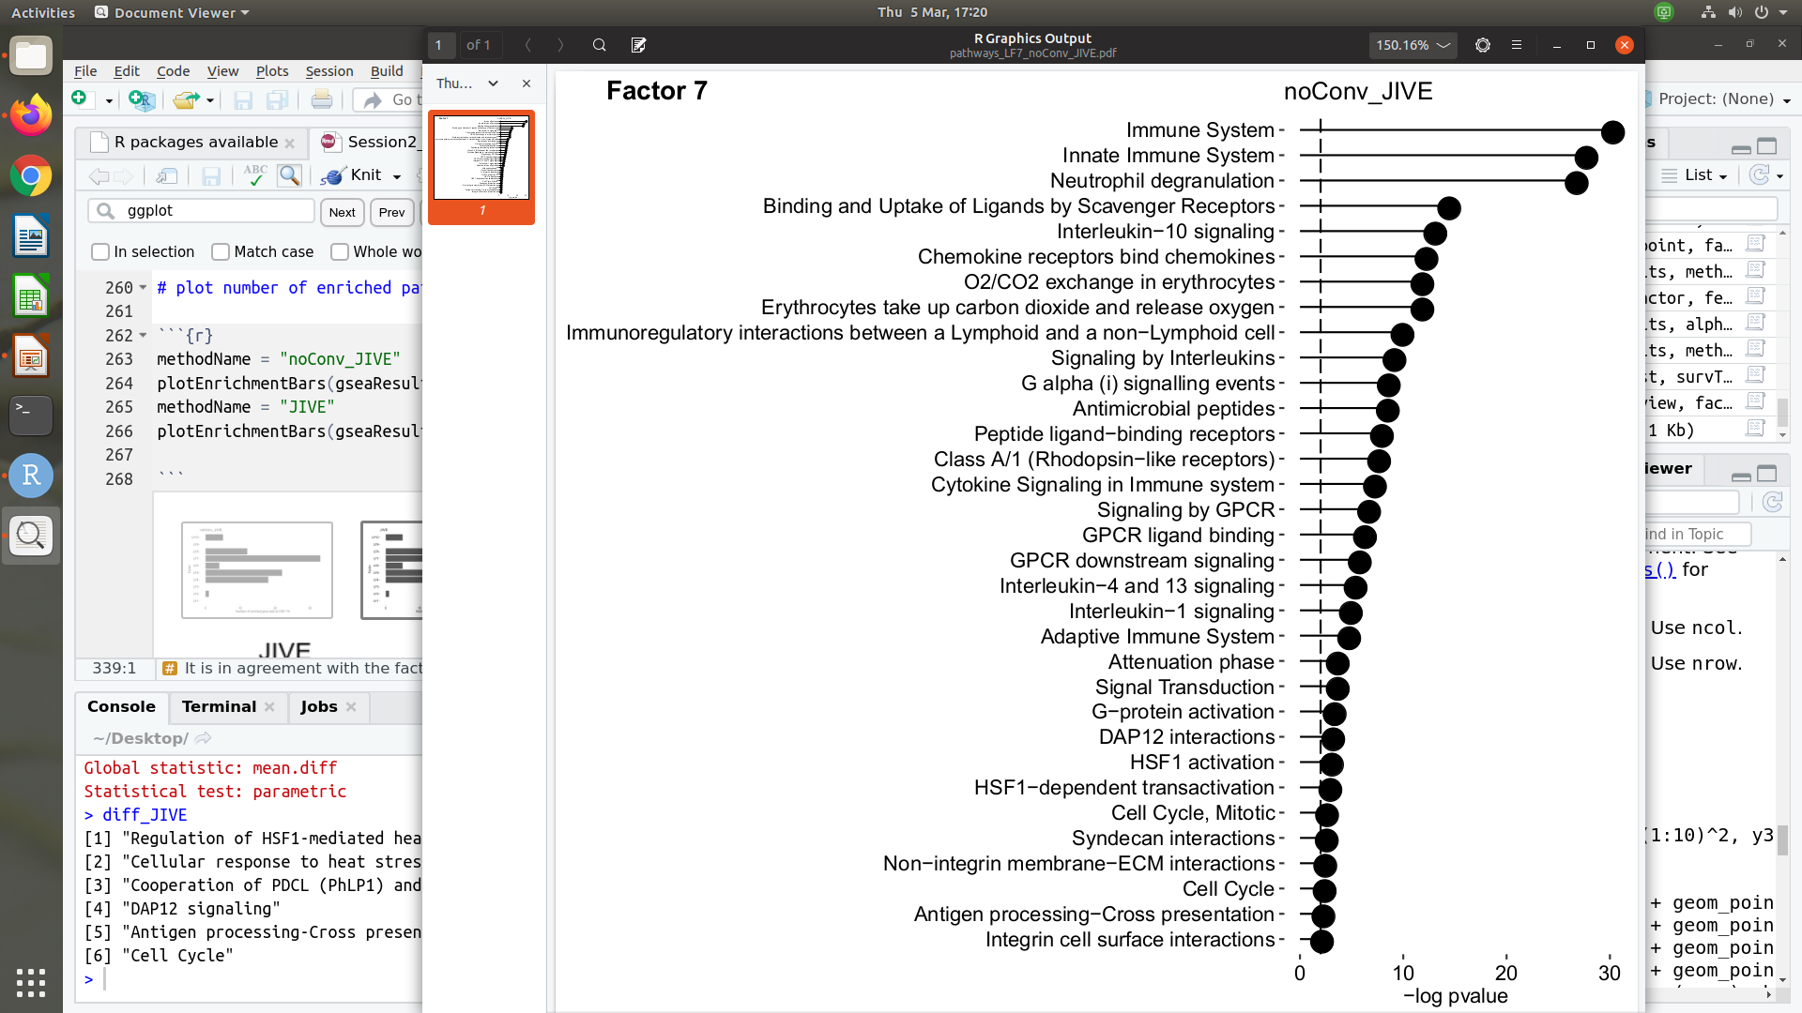
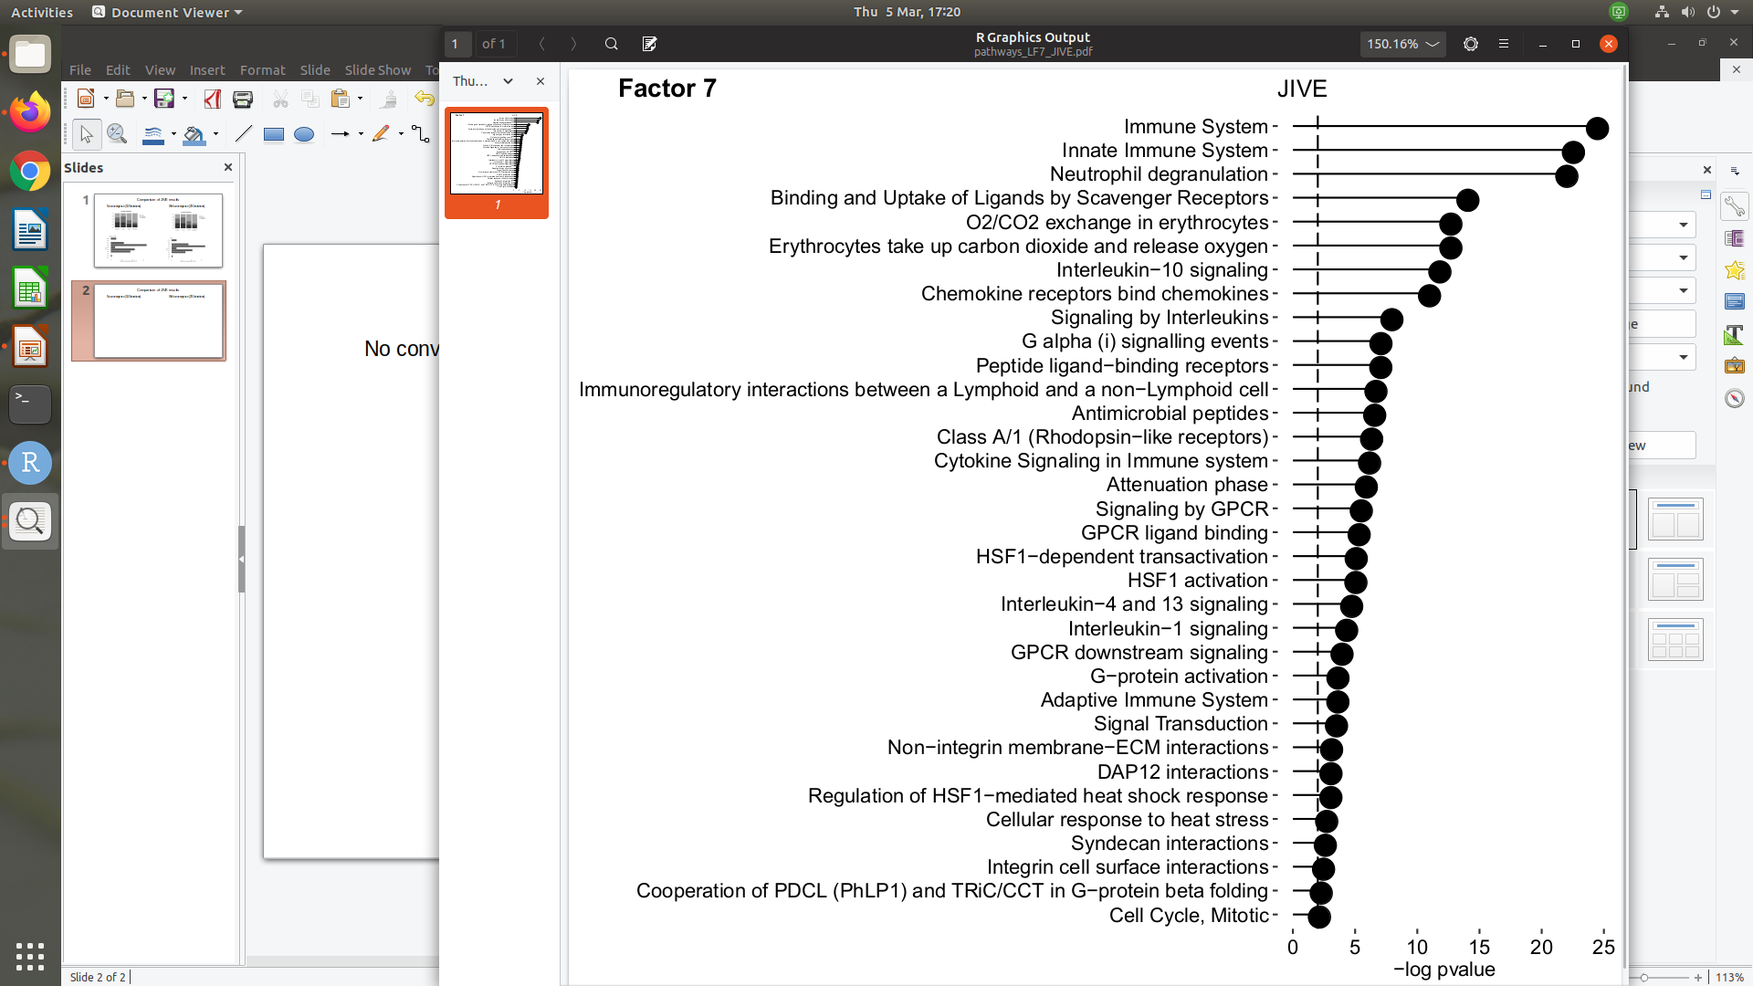
3. JIVE and Convergence
Approach | selectivity | nonZeroFacs | total_pathways
Convergence | 0.3505155 | 7 | 61
No convergence | 0.3578947 | 7 | 61
No convergence (100 iterations)
With convergence (291 iterations)
“When focusing on the underlying biology of the metagenes,
tICA and MCIA should be prioritized. Indeed, we showed that
these approaches are efficient to detect pathways or processes...”
Cantini et al., 2020 biorxiv

Slide 10
Further Work?
Determine how sample size affects clinical survivability/time to treatment for each of the methods
K-means, EM, mixture-modelling etc clustering of factor vs factor scatterplots (slide 6) → classify different clinical presentations based on this?
Determine overlaps of predicted patients in each category vs clinical presentations from clinical data
Use as a method to discriminate clinical phenotypes?

Slide 11


